Slide 1
게임엔진2 제12주
Messaging Systsm
드론IoT시뮬레이션학부
담당교수 : 이형원
E304호, hwlee@inje.ac.kr

Slide 2


Sending Events with RPC
RPC: Remote Procedure Call
동일한 실행파일에 있지 않은 함수를 호출하는 행위
Call P(x,y,z)
Return (P)
Network
Server
Client

Slide 3
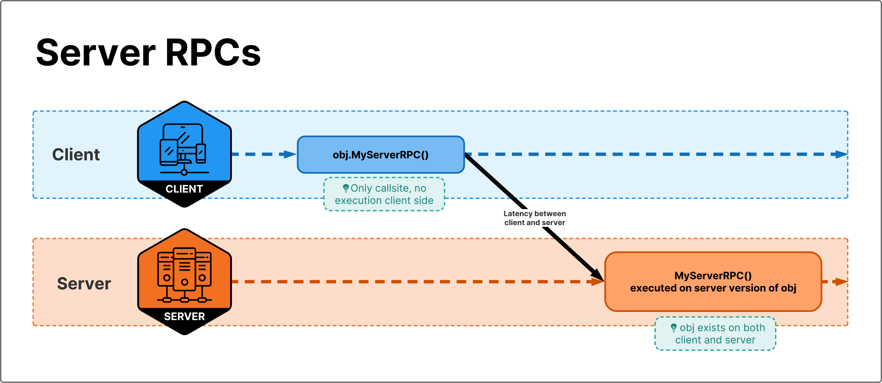
Client can invoke a server RPC on a Network Object. The RPC will be placed in the local queue and then sent to the server, where it will be executed on the server version of the same Network Object.

Slide 4
Server RPCs
At a high level, when calling an RPC client side, the SDK will take a note of the object, component, method and any parameters for that RPC and send that information over the network. The server will receive that information, find the specified object, find the specified method and call it on the specified object with the received parameters.
When calling an RPC, you call a method remotely on an object that could be anywhere in the world. They are "events" you can trigger when needed.
If you call an RPC method on your side, it will execute on a different machine.

Slide 5
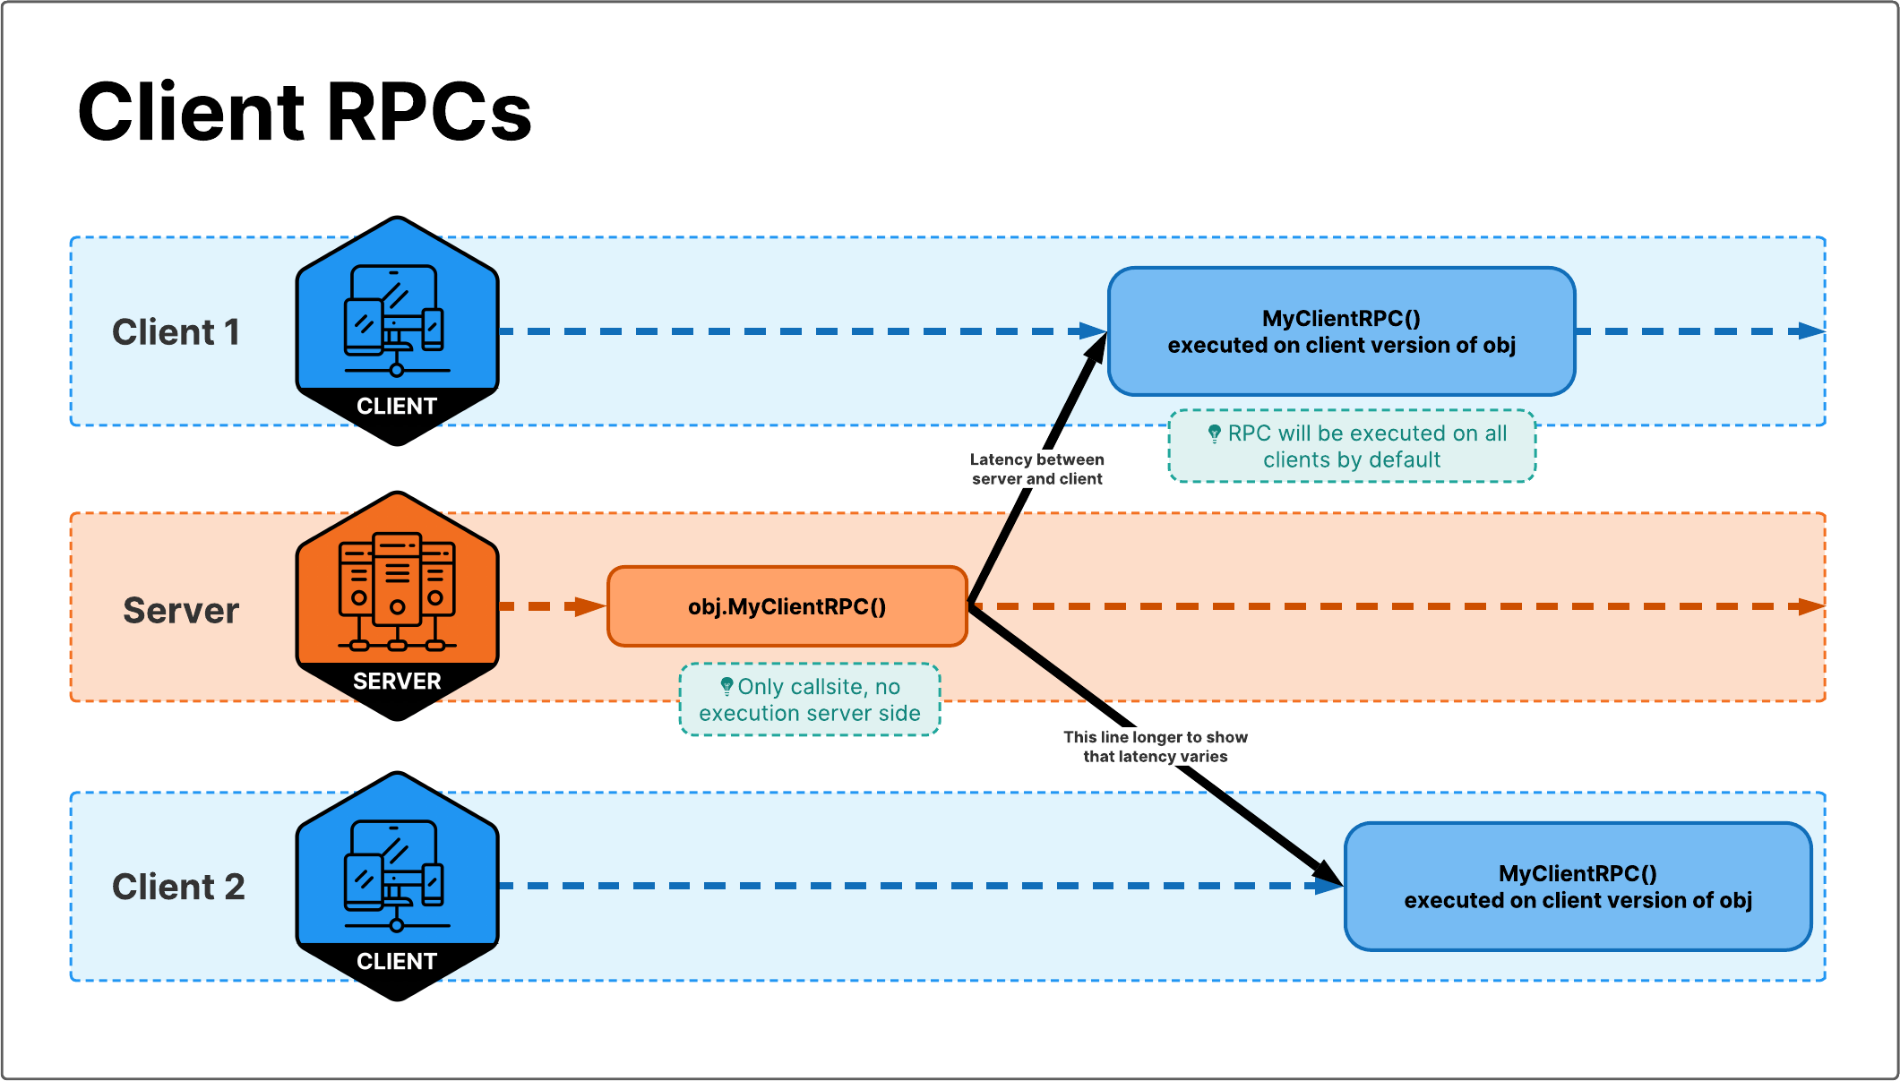
Server can invoke a client RPC on a Network Object. The RPC will be placed in the local queue and then sent to a selection of clients (by default this selection is "all clients"). When received by a client, RPC will be executed on the client's version of the same Network Object.

Slide 7
Declaring a Client RPC
Developers can declare a ClientRpc by marking a method with [ClientRpc] attribute and making sure to have ClientRpc suffix in the method name.
[ClientRpc]
void PongClientRpc(int somenumber, string sometext) { /* ... */ }

Slide 8
Invoking a ClientRPC
Developers can invoke a ClientRpc by making a direct function call with parameters:
void Update()
{
if (Input.GetKeyDown(KeyCode.P))
{
PongClientRpc(Time.frameCount, "hello, world"); // Server -> Client
}
}
// Error: Invalid, missing 'ClientRpc' suffix in the method name
[ClientRpc]
void Pong(int somenumber, string sometext) { /* ... */ }
// Error: Invalid, missing [ClientRpc] attribute on the method
void PongClientRpc(int somenumber, string sometext) { /* ... */ }

Slide 9
To Send to One Client, use ClinetRpcSendParameters
private void DoSomethingServerSide(int clientId)
{
// If is not the Server/Host then we should early return here!
if (!IsServer) return;
// NOTE! In case you know a list of ClientId's ahead of time, that does not need change,
// Then please consider caching this (as a member variable), to avoid Allocating Memory every time you run this function
ClientRpcParams clientRpcParams = new ClientRpcParams
{
Send = new ClientRpcSendParams
{
TargetClientIds = new ulong[]{clientId}
}
};
// Let's imagine that you need to compute a Random integer and want to send that to a client
const int maxValue = 4;
int randomInteger = Random.Range(0, maxValue);
DoSomethingClientRPC(randomInteger, clientRpcParams);
}
[ClientRpc]
private void DoSomethingClientRPC(int randomInteger, ClientRpcParams clientRpcParams = default)
{
if (IsOwner) return;
// Run your client-side logic here!!
Debug.LogFormat("GameObject: {0} has received a randomInteger with value: {1}", gameObject.name, randomInteger);
}

Slide 10
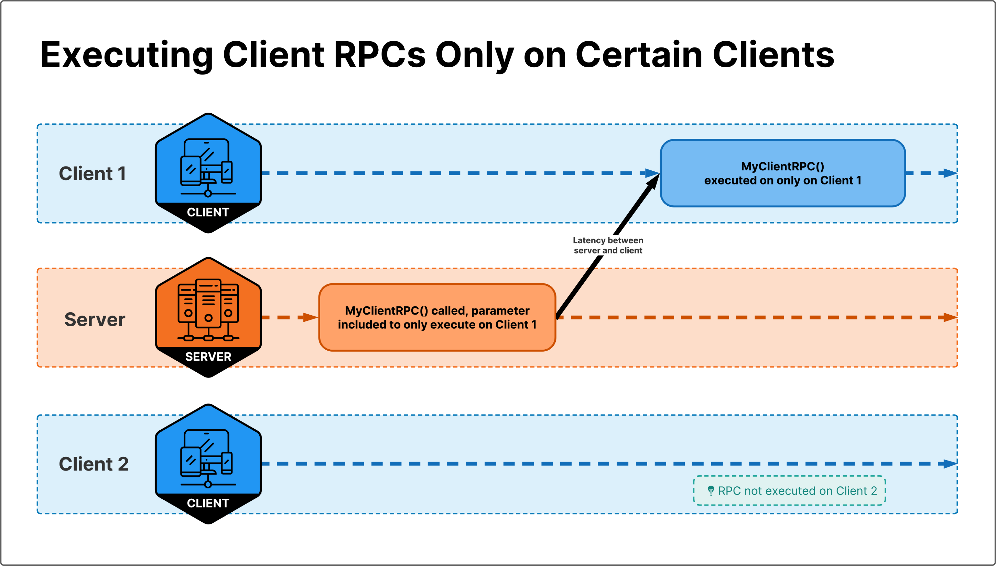

Slide 11
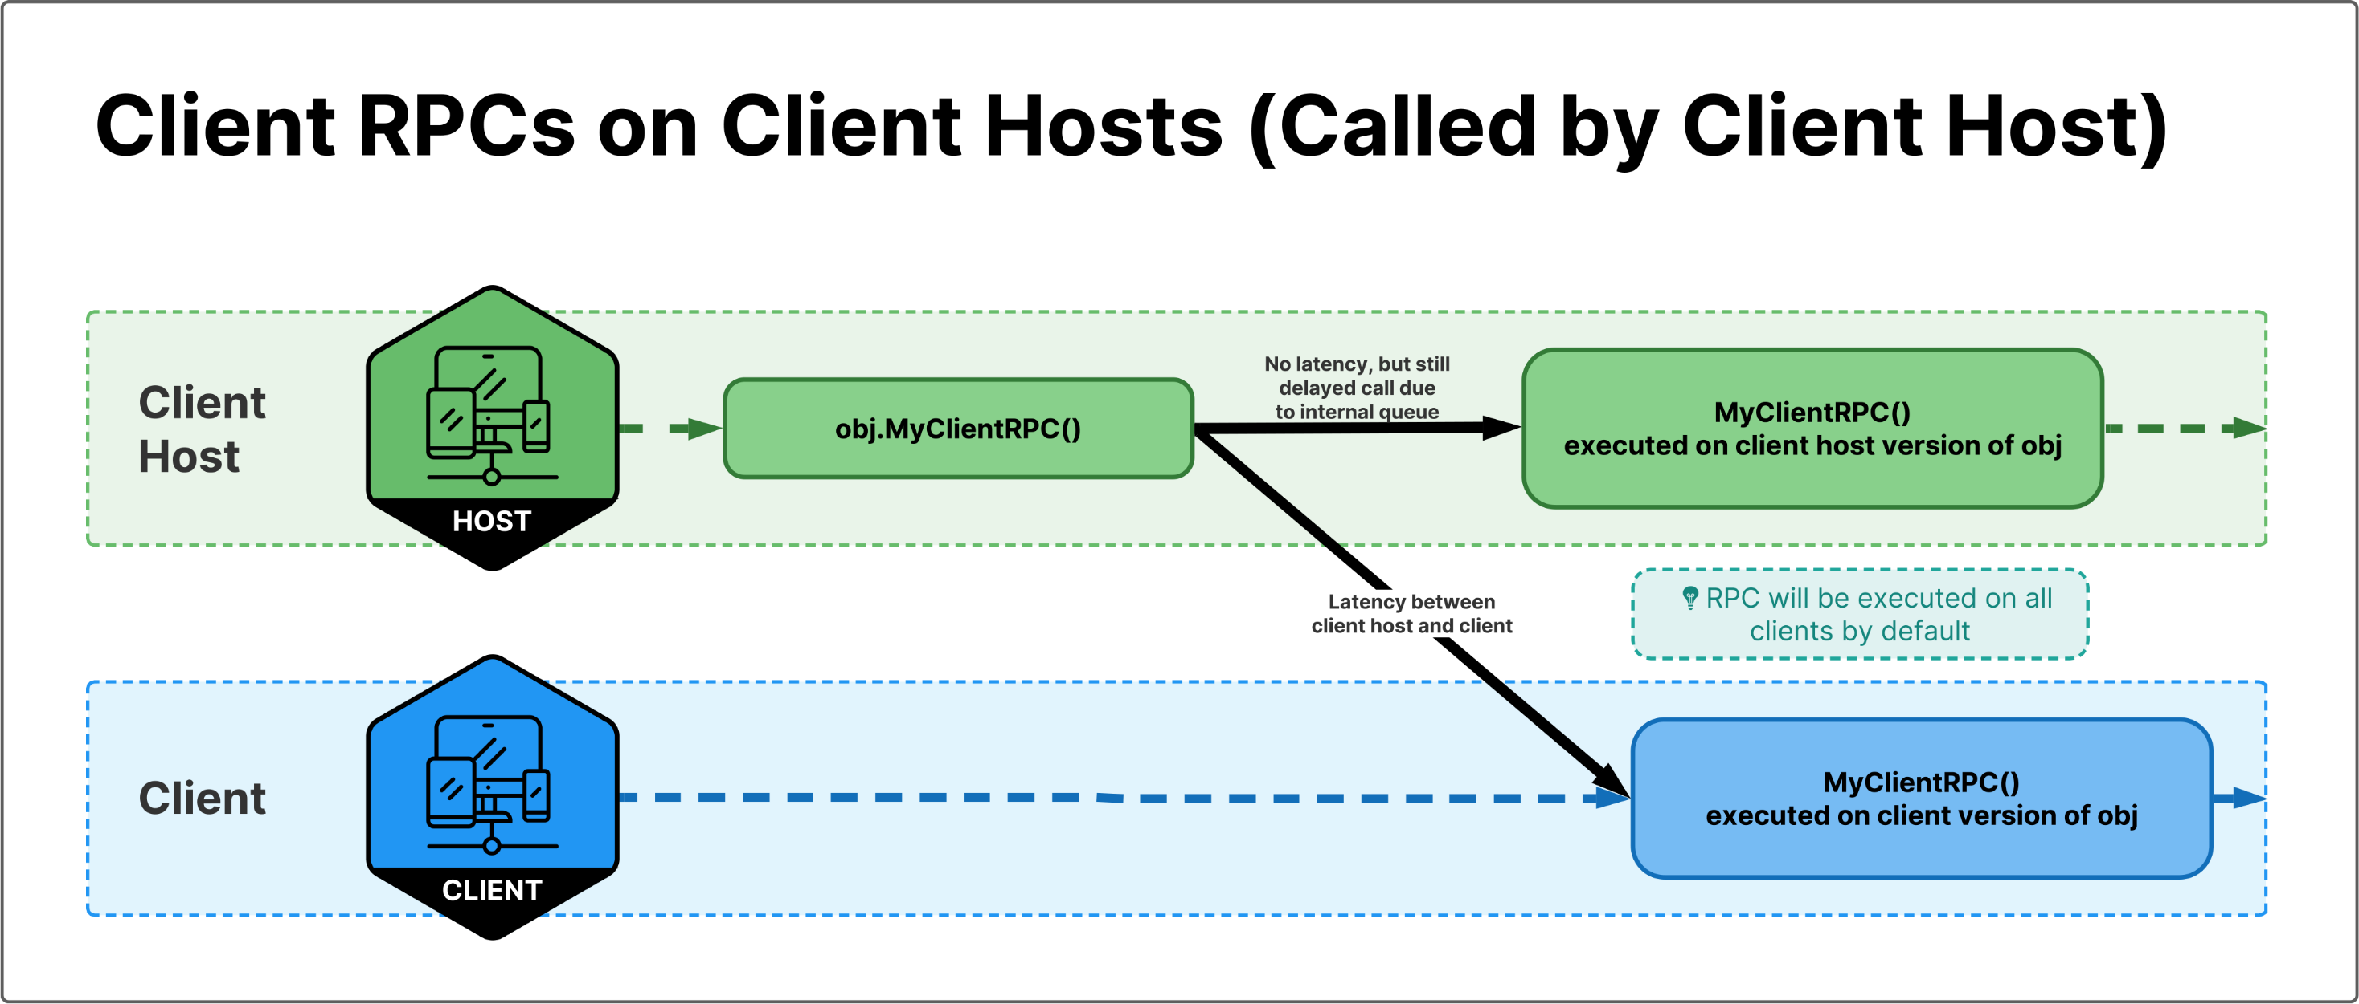
Invoking a Client RPC from the Host

Slide 12
ServerRPC
A ServerRpc provides you with the ability to send information from a client to a server just like you would invoke a method from within a class. A ServerRpc is a remote procedure call (RPC) that can be only invoked by a client and will always be received and executed on the server/host.
ServerRpc | Unity Multiplayer Networking (unity3d.com)

Slide 13
Declaring a ServerRPC
Creating a method that ends with the ServerRpc suffix within a NetworkBehaviour derived class.
Adding the [ServerRpc] attribute above the method
public class SomeNetworkBehaviour : NetworkBehaviour
{
[ServerRpc]
public void PingServerRpc(int pingCount)
{
}
}
The above example uses the default [ServerRpc] attribute settings which only allows a client owner (client that owns NetworkObject associated with the NetworkBehaviour containing the ServerRpc method) invocation rights. Any client that is not the owner will not be allowed to invoke the ServerRpc.

Slide 14
ServerRPC Ownership and ServerRpcParams
There are times where you might want any client to have ServerRpc invocation rights. You can easily accomplish this by setting the ServerRpc attribute's RequireOwnership parameter to false like in the example below:
[ServerRpc(RequireOwnership = false)]
public void MyGlobalServerRpc(ServerRpcParams serverRpcParams = default)
{
var clientId = serverRpcParams.Receive.SenderClientId;
if (NetworkManager.ConnectedClients.ContainsKey(clientId))
{
var client = NetworkManager.ConnectedClients[clientId];
// Do things for this client
}
}
In the above example, you will also notice that MyGlobalServerRpc takes a single parameter of type ServerRpcParams. This parameter type is optional, but it can be very useful to identify which client was requesting the server invoke the RPC. The ServerRpcParams.Receive.SenderClientId property is automatically set upon the server receiving the ServerRpc request and used to get the server-side NetworkClient instance of the client (sender).

Slide 15
Owner Example
[ServerRpc]
public void PlayerOwnerShootGunServerRpc(Vector3 lookWorldPosition)
{
if (NetworkManager.ConnectedClients.ContainsKey(OwnerClientId))
{
var client = NetworkManager.ConnectedClients[OwnerClientId];
var castRay = new Ray(client.PlayerObject.transform.position, lookWorldPosition);
RaycastHit rayCastHit;
if (Physics.Raycast(castRay, out rayCastHit, 100.0f))
{
// Handle shooting something
}
}
}

Slide 16
Invoking a ServerRPC
From the example below that uses the PlayerOwnerShootGunServerRpc method, you can see that you would invoke it just any other method:
private void Update()
{
if (!IsSpawned || !IsOwner)
{
return;
}
if (Input.GetKeyDown(KeyCode.Space))
{
var point = new Vector3();
var currentEvent = Event.current;
var mousePos = new Vector2();
// Get the mouse position from Event.
// Note that the y position from Event is inverted.
mousePos.x = currentEvent.mousePosition.x;
mousePos.y = Camera.current.pixelHeight - currentEvent.mousePosition.y;
point = Camera.current.ScreenToWorldPoint(new Vector3(mousePos.x, mousePos.y, Camera.current.nearClipPlane));
PlayerOwnerShootGunServerRpc(point);
}
}

Slide 17
ServerRPC timing

Slide 18
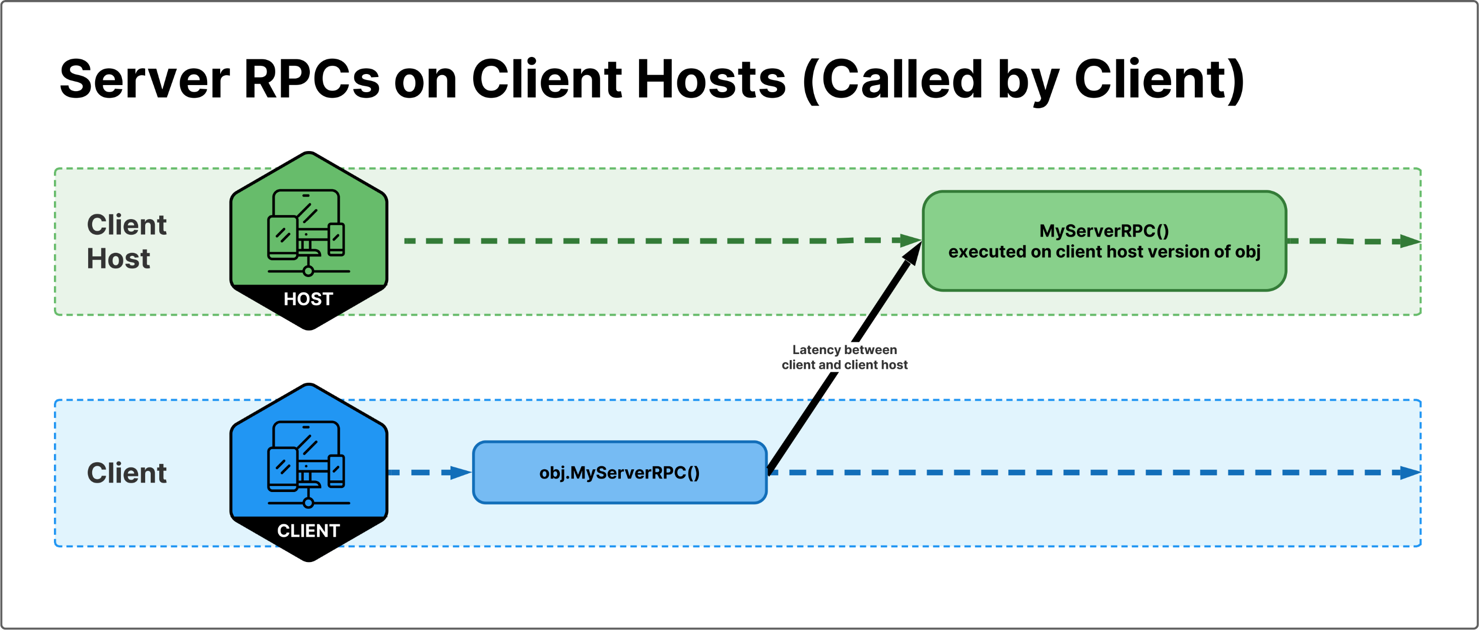

Slide 19
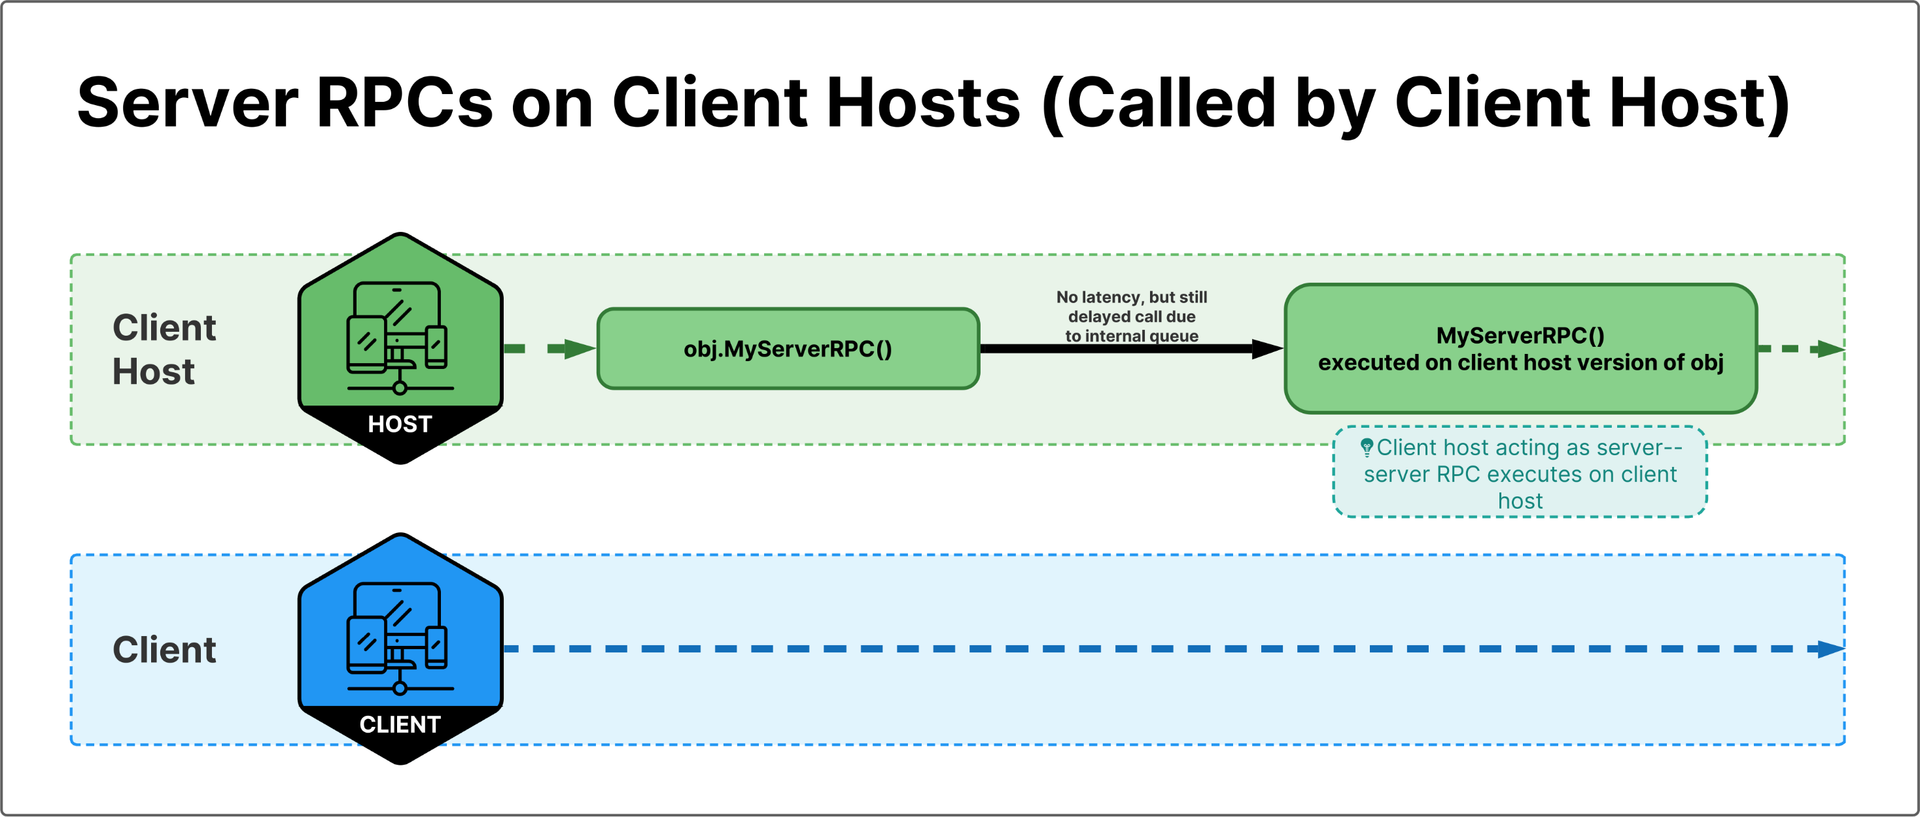

Slide 20
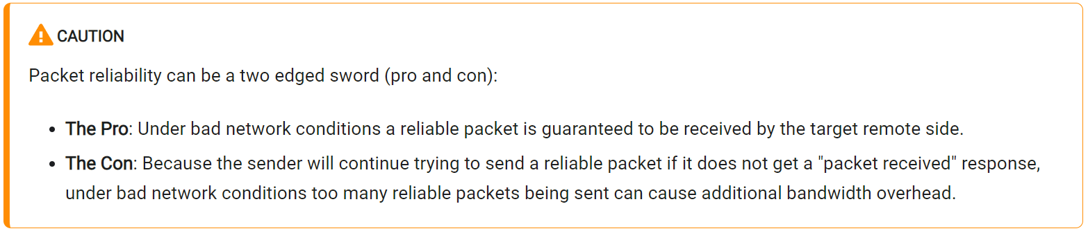
Realiability
RPCs are reliable by default. This means they are guaranteed to be received and executed on the remote side. However, sometimes developers might want to opt-out reliability, which is often the case for non-critical events such as particle effects, sounds effects etc.

Slide 21
Realiable and Unrealiable RPC Examples:
[ServerRpc]
void MyReliableServerRpc() { /* ... */ }
[ServerRpc(Delivery = RpcDelivery.Unreliable)]
void MyUnreliableServerRpc() { /* ... */ }
[ClientRpc]
void MyReliableClientRpc() { /* ... */ }
[ClientRpc(Delivery = RpcDelivery.Unreliable)]
void MyUnreliableClientRpc() { /* ... */ }
Reliable RPCs will be received on the remote end in the same order as they are fired but this in-order guarantee only applies to RPCs on the same NetworkObject. Different NetworkObjects might have reliable RPCs called but executed in different order compared to each other. To put more simply, in-order reliable RPC execution is guaranteed per NetworkObject basis only. If you determine an RPC is being updated frequently (i.e. several times per second), it might be better suited as an unreliable RPC.

Slide 22
Additional RPC Facts
An RPC call made without an active connection will not be automatically added to the send queue and will be dropped/ignored.
Both reliable and unreliable RPC calls have to be made when there is an active network connection established between a client and the server. The caveat to this rule is if you are running a host since a host is both a server and a client:
A host can send RPC messages from the "host-server" to the "host-client" and vice versa.
Reliable RPC calls made during connection will be dropped if the sender disconnects before the RPC is sent.

Slide 23


Execution Table
Function | Server | Client | Host(Server+Client)
ServerRPC Send
ServerRPC Execute
ClientRPC Send
ClientRPC Execute
An RPC function typically doesn't execute its body immediately since the function call really is a stand-in for a network transmission. Since the host is both a client and a server, local RPCs targeting the host-server or host-client are invoked immediately. As such, avoid nesting RPCs when running in host mode as a ServerRpc method that invokes a ClientRpc method that invokes the same ServerRpc method (and repeat...) could cause a stack overflow.

Slide 24
Pseudo-code sample for ServerRPC
[ServerRpc]
void MyServerRpc(int somenumber, string somestring)
{
// --- begin: injected framework-code
if (NetworkSend())
{
// this block will be executed if:
// - called from user-code on client
// - called from user-code on host
var writer = NetworkCreateWriter();
writer.WriteInt32(1234567890); // RPC method signature hash
writer.WriteInt32(somenumber);
writer.WriteChars(somestring);
NetworkSendRpc(writer);
}
if (NetworkReturn())
{
// this block will be executed if:
// - called from user-code
// - called from framework-code on client
return;
}
// --- end: injected framework-code
print($"MyServerRpc: {somenumber}");
}

Slide 30
RPC Params
Both ServerRpc and ClientRpc methods can be configured either by [ServerRpc] and [ClientRpc] attributes at compile-time and ServerRpcParams and ClientRpcParams at runtime.
Developers can put ServerRpcParams and ClientRpcParams as the last parameter (optionally). They can also be used for a consolidated space for XXXRpcReceiveParams and XXXRpcSendParams.
The network framework will inject the corresponding XXXRpcReceiveParams to what the user had declared in code when invoked by network receive handling (framework code) and will consume XXXRpcSendParams when invoked by RPC send call (user code).

Slide 31
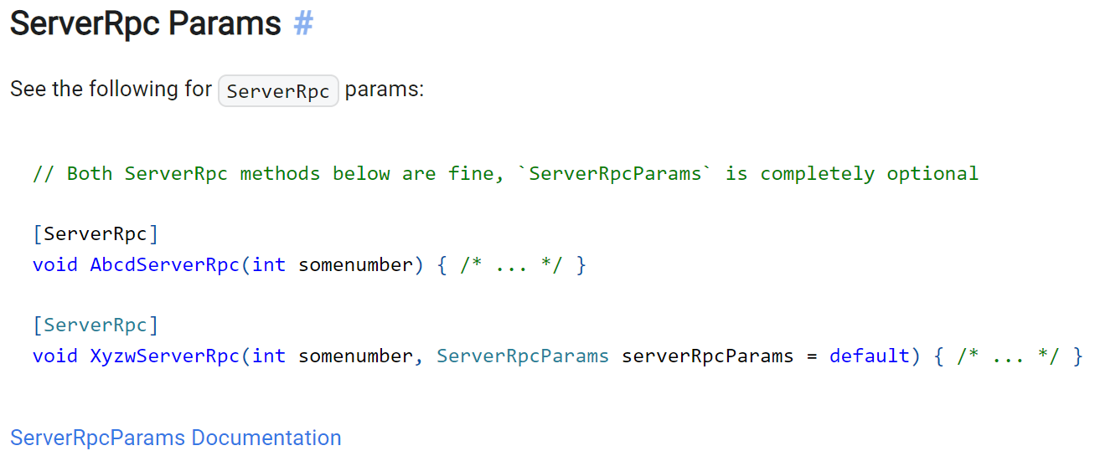
https://docs-multiplayer.unity3d.com/netcode/current/api/Unity.Netcode.ServerRpcParams

Slide 32
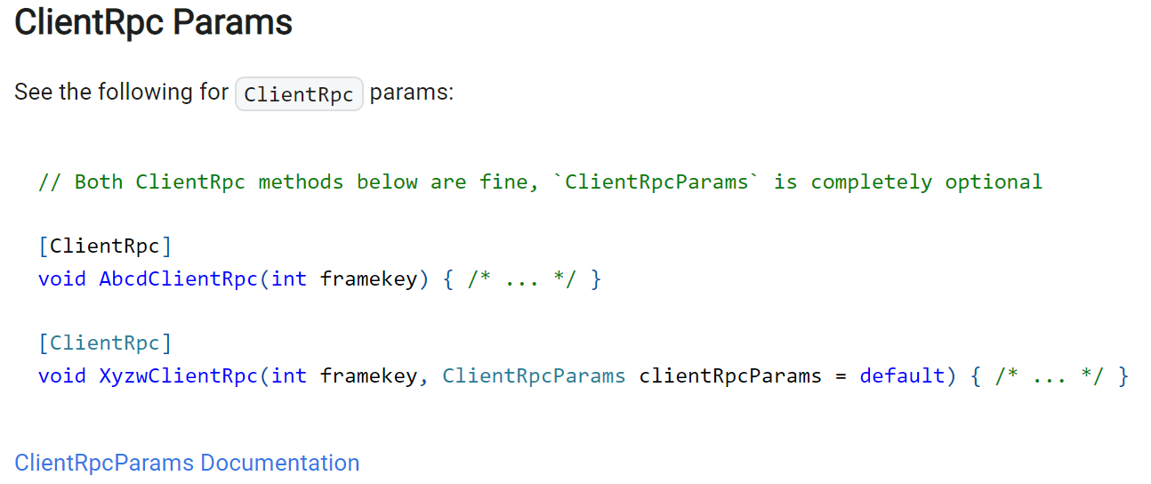
https://docs-multiplayer.unity3d.com/netcode/current/api/Unity.Netcode.ClientRpcParams

Slide 33
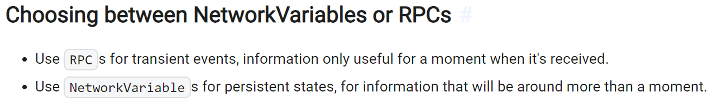
RPC vs NetwrokVariable
Choosing the wrong data syncing mecanism can create bugs, generate too much bandwidth and add too much complexity to your code. Netcode for GameObjects (Netcode) has two main ways of syncing information between players. RPC (Remote Procedure Call) and replicated state (NetworkVariable). They both send messages over the network. The logic and your design around how they send messages is what will make you choose one over the other.
A quick way to choose which to use is to ask yourself: "Should a player joining mid-game get that information?"

Slide 34
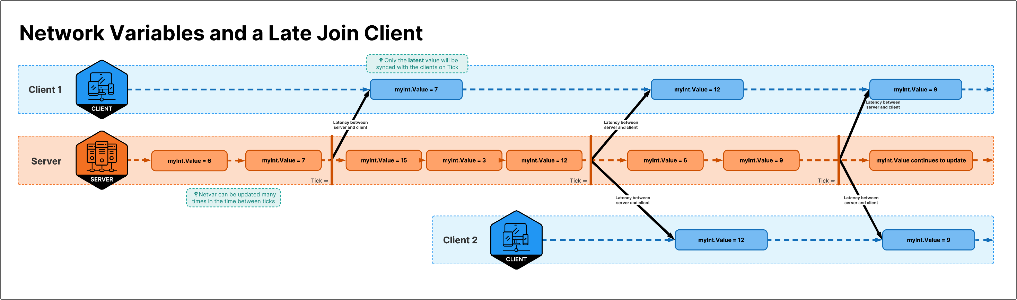
Network Variables allow to seamlessly catch up late joining clients by sending the current state as soon as the tick happens.

Slide 35
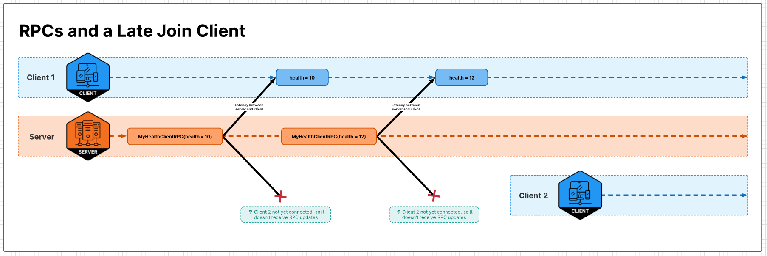
Sending state with RPCs will not be transmitted to late joining clients.

Slide 36
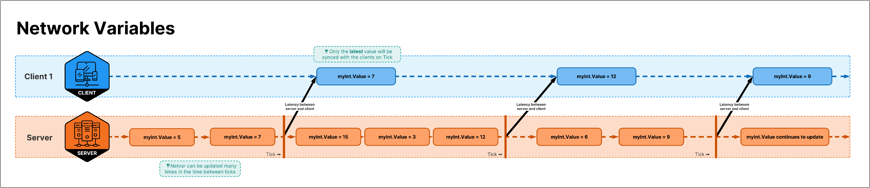
Network Variables can be updated multiple times between ticks, but only the latest will be synced to other peers.

Slide 37
Why not use NetworkVariables for everything?
RPCs are simpler.
If you have a temporary event like an explosion, you do not need a replicated state for this. It would not make sense. You would have an "unexploded" state that would need to be synced everytime a new player connected? From a design perspective, you might not want to represent these events as state.
An explosion could use an RPC for the event, but the effect of the explosion should be using NetworkVariables ( for example player's knockback and health decrease). A newly connected player doesn't care about an explosion that happened 5 seconds ago. They do care about the current health of the players around that explosion though.
Actions in Boss Room are a great example for this. The area of effect action (AoeAction) triggers an RPC when the action is activated (showing a VFX around the affected area). The imp's health (NetworkVariables) is updated. If a new player connects, they will see the damaged imps. We would not care about the area of effect ability's VFX, which works great with a transient RPC.

Slide 38
AoeActionInput.cs Shows the input being updated client side and not waiting for the server. It then calls an RPC when clicking on the area to affect.
AOEAction.cs Server side logic detecting enemies inside the area and applying damage. It then broadcasts an RPC to tell all clients to play the VFX at the appropriate position. Character's state will automatically update with their respective NetworkVariables update (health and alive status for example).
AoeActionFX.cs is triggered by an RPC coming from the server
Unity-Technologies/com.unity.multiplayer.samples.coop: A small-scale cooperative game sample built on the new, Unity networking framework to teach developers about creating a similar multiplayer game. (github.com)

Slide 39
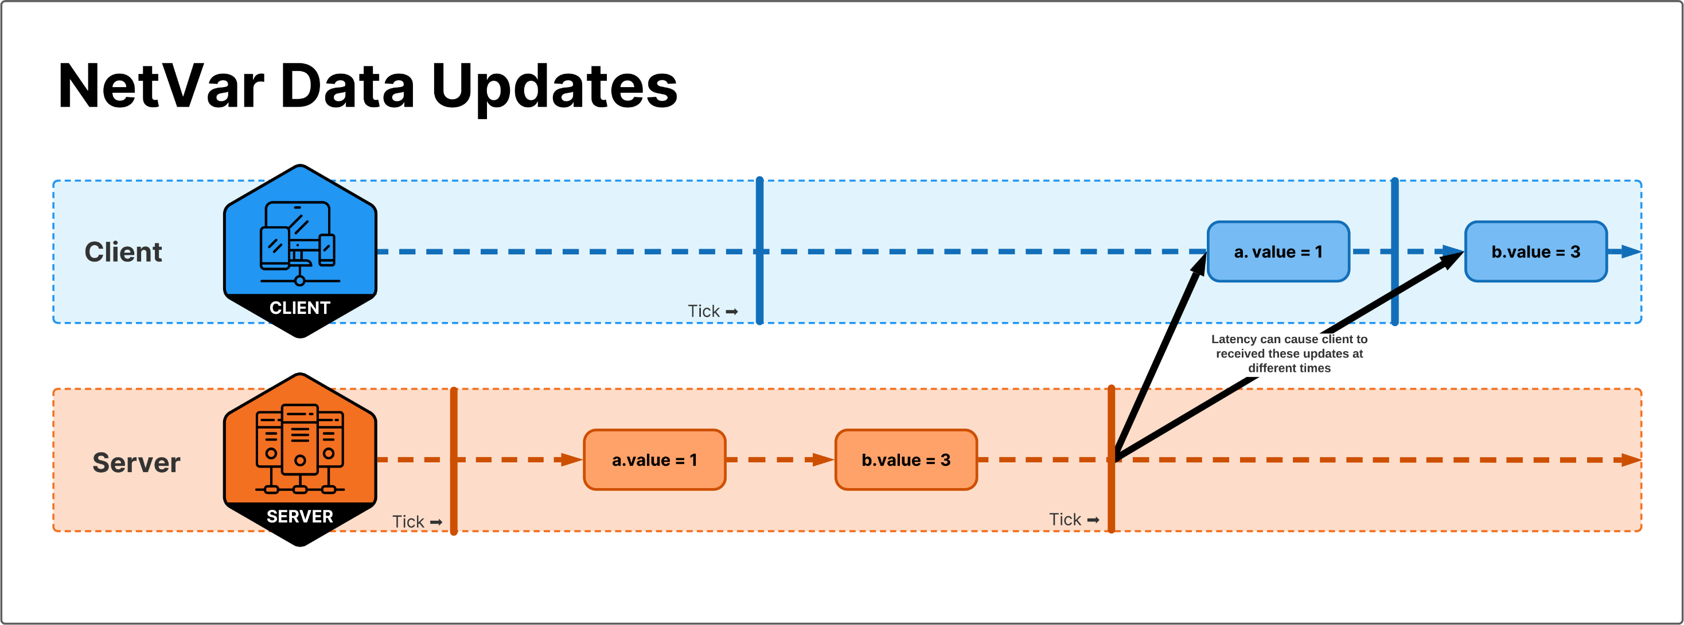
Different Network Variables updated within the same tick are not guranteed to be delivered to the clients at the same time.

Slide 40
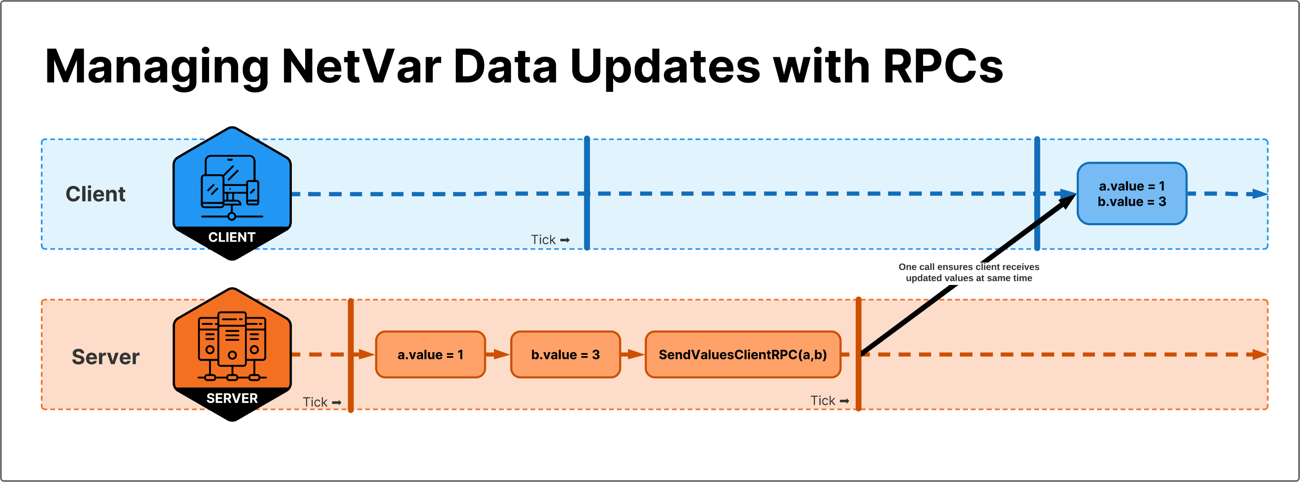
To ensure that several different Network Variables are all synchronized at the same exact time we can use client RPC to join these value changes together.

Slide 41


Summary
NetworkVariables are great for managing state, to make sure everyone has the latest value. Use them when you want to make sure newly connected players get an up to date world state.
RPCs are great for sending transient events. Use them when transmiting short lived events.

Slide 42
Network Update Loop
Initialization
Early Update
FixedUpdate
PreUpdate
Update
PreLateUpdate
PostLateUpdate

Slide 43
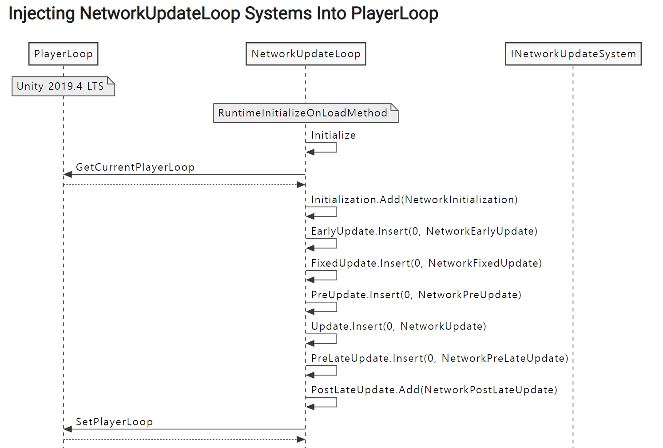
Network Update Loop
Network Update Loop Reference | Unity Multiplayer Networking (unity3d.com)

Slide 44
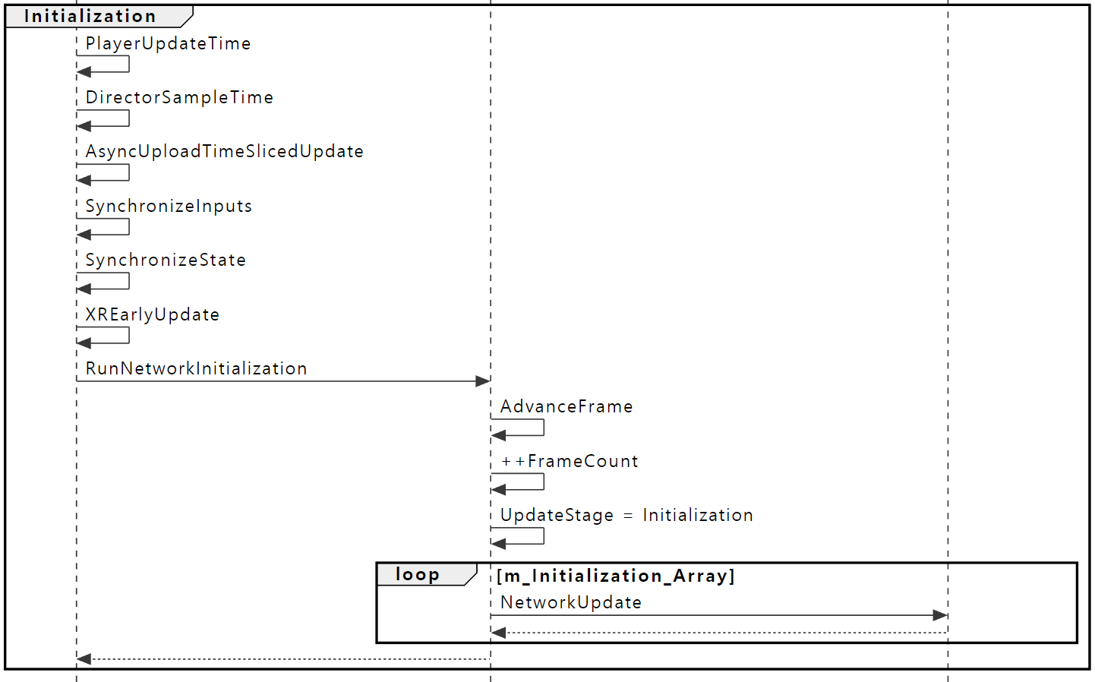

Slide 45
Custom Message
Unnamed Messages
Unnamed messages can be thought of as a single sending channel.
Named Messages
Custom named messages use the "message name" as the unique identifier

Slide 46
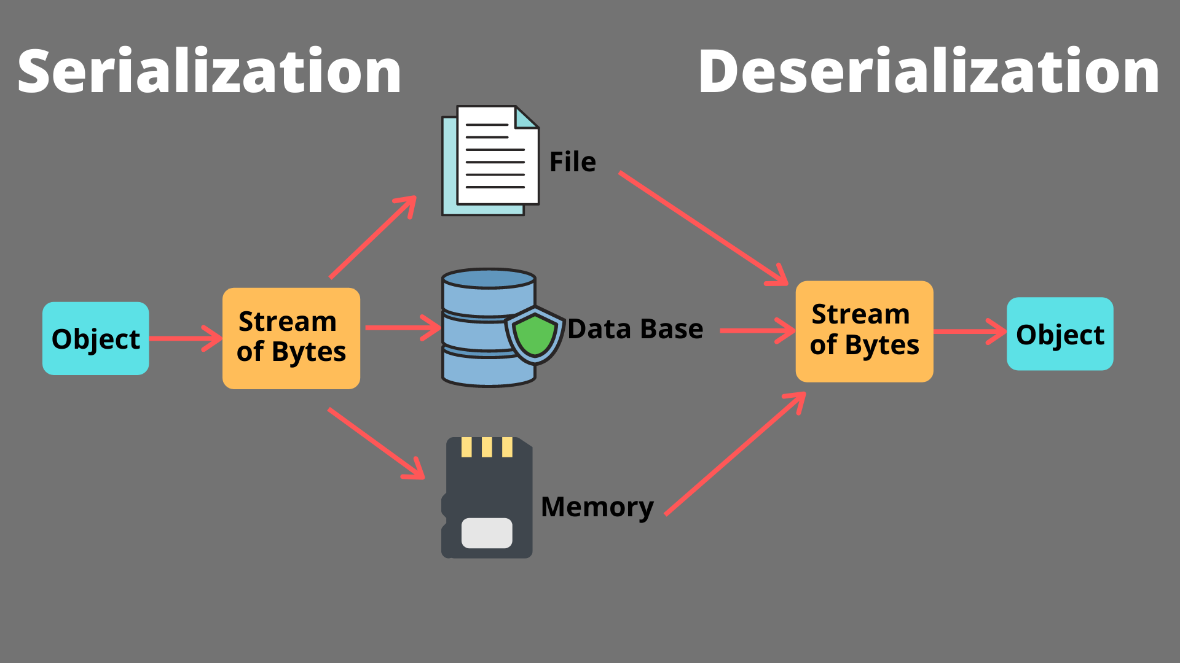
Serialization
메모리를 디스크에 저장하거나 네트워크 통신에 사용하기 위한 형식으로 변환하는 것을 말한다.
Network

Slide 47
Serializable
C# Primitives
Bool, char, sbyte, byte, short, ushort, int, uint, long, ulong, float, double, string
Unity Primitives
Color, Color32, Vector2, Vector3, Vector4, Quaternion, Ray, Ray2D
Enum Types
Arrays
Arrays of C# Primitives, Unity Primitives
INetworkSerializable
Custom Serialization
NetworkObject & NetworkBehaviour

Slide 48
RPCs vs NetworkVariable Example
https://github.com/Unity-Technologies/com.unity.multiplayer.samples.coop/
This page contains examples of how RPCs or NetworkVariables have been used in the Small Coop Sample (Boss Room Project). It should provide some guidance on when to use RPCs or NetworkVariables in your own projects.
See the RPC vs NetworkVariable tutorial for more information.

Slide 49
RPCs for movement
com.unity.multiplayer.samples.coop/ClientInputSender.cs at main · Unity-Technologies/com.unity.multiplayer.samples.coop (github.com)
com.unity.multiplayer.samples.coop/ServerCharacter.cs at main · Unity-Technologies/com.unity.multiplayer.samples.coop (github.com)
We want the full history of inputs sent, not just the latest value. There is no need for NetworkVariables, you just want to blast your inputs to the server. Since Boss Room is not a twitch shooter, we send inputs as reliable RPCs without worrying about the additional latency an input loss would add.

Slide 50
Sending action inputs RPCs
The following RecvPerformHitReactionClient call sends actions from server to client:
NetworkCharacterState.cs

Slide 51
Arrow’s GameObject vs Fireball’s VFX
The archer's arrows uses a standalone GameObject that is replicated over time. Since this object's movements are slow, we made the choice to use state (via the NetworkTransform) to replicate this ability's status, in case a client connected while the arrow was flying.
ServerProjectileLogic.cs
We could have used an RPC instead, for example the Mage's projectile attack. Since it is expected for that projectile to be quick, we are not affected by the few milliseconds where a newly connected client could miss the projectile and we save on bandwidth having to manage a replicated object. Instead a single RPC is sent to trigger the FX client side.
FXProjectileTargetedAction.cs

Slide 52
Breakable state
We could have used a "break" RPC to set a breakable object as broken and play the appropriate visual effects. Applying our "should that information be replicated when a player joins the game mid-game" rule of thumb, we used NetworkVariables instead. We used the OnValueChanged callback on those values to play our visual effects, as well as an initial check when spawning the NetworkBehaviour.
NetworkBreakableState.cs
ClientBreakableVisualization.cs

Slide 53
Hit points
All of our characters and objects' hit points are synced through NetworkVariables, easily collecting and providing data.
If this was done through RPCs, we would need to keep a list of RPCs to send to connecting players to ensure they get the latest hit point values for each object. Keeping a list of RPCs for each object to send to those RPCs on connecting would be a maintainability nightmare. By using NetworkVariables, we let the SDK do the work for us.

Slide 54
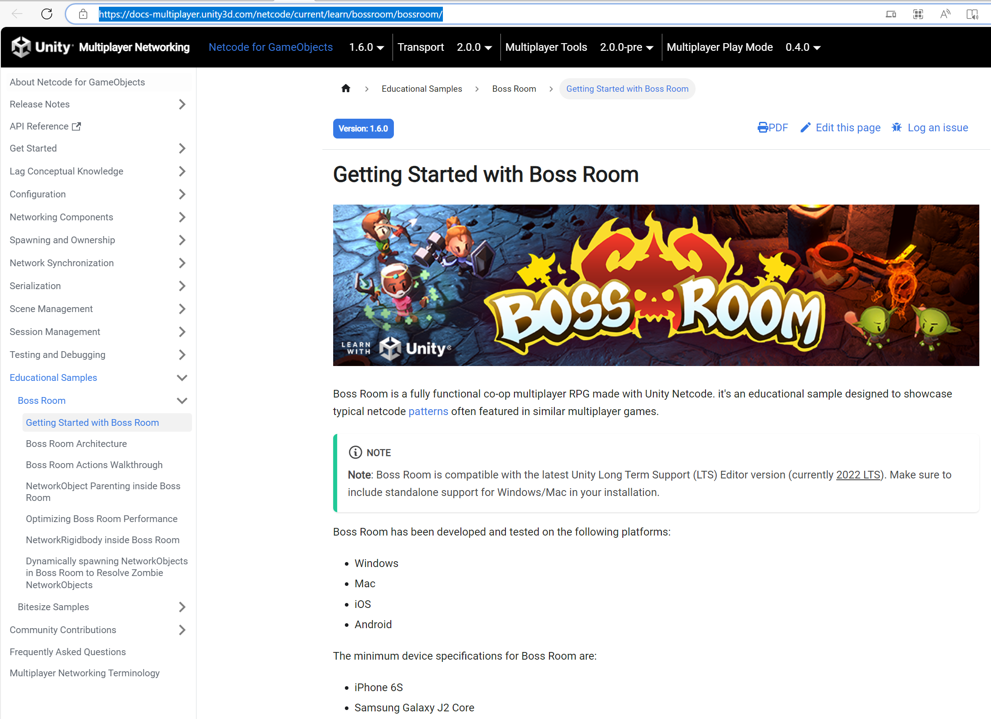

Slide 55
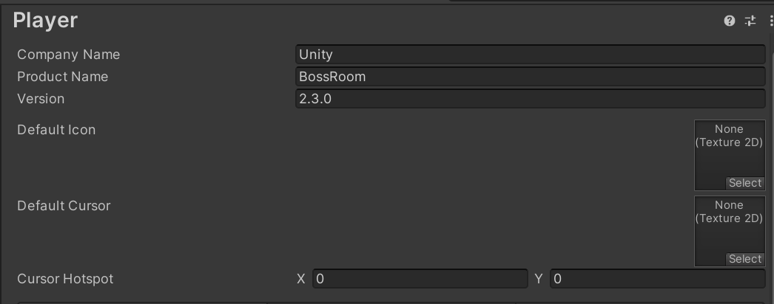
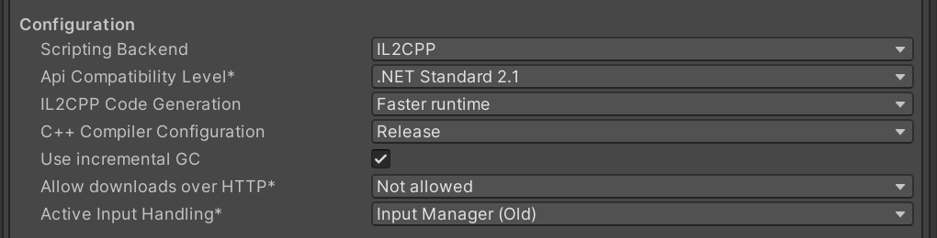

Slide 56
할일
BossRoom Game 완성(Boss Room – Small scale multiplayer co-op game sample | Unity)
Getting Started with Boss Room | Unity Multiplayer Networking (unity3d.com)

